Slide 1

HR Appraisal LAUNCH PROCESS Process of initiating HR Appraisal Process
Presented By :
Akash Nanaware
(Aster Batch)

Slide 2
INDEX
Introduction
Aims & Objectives
Methodology
Project Flow
Data Flow Diagram
Use case Diagram
Result
Advantages
Limitations
Conclusion

Slide 3
Introduction
This bot will communicate between HR and employee
Accuracy
Clear Appraisal Schedule
Sending multiple mails at a time
Self Appraisal Submission Status
Sending Reminder mail.

Slide 4
Aims & Objectives
The aim of the Appraisal Initiation Bot is to automate and optimize the launching of appraisal process from send mails to eligible candidates, collecting and validating self-appraisal forms.
Accuracy Improvement
To minimize manual processing time
Submission Status Tracking
Saving time

Slide 5
Methodology
Part 1-Bot
Check Master Data Files
Calculate Dates & Separate eligible data
Store Valid data in DB
Start
Validate
Files Data
Send mail
to eligible
End

Slide 6
Methodology
Part 2-Bot
Separate forms data: correct, incomplete and complete
Read received mails
Validate attachment data
Update DB status respectively
Send mail to refill if incorrect form
Send remainder mail
Start
End

Slide 7
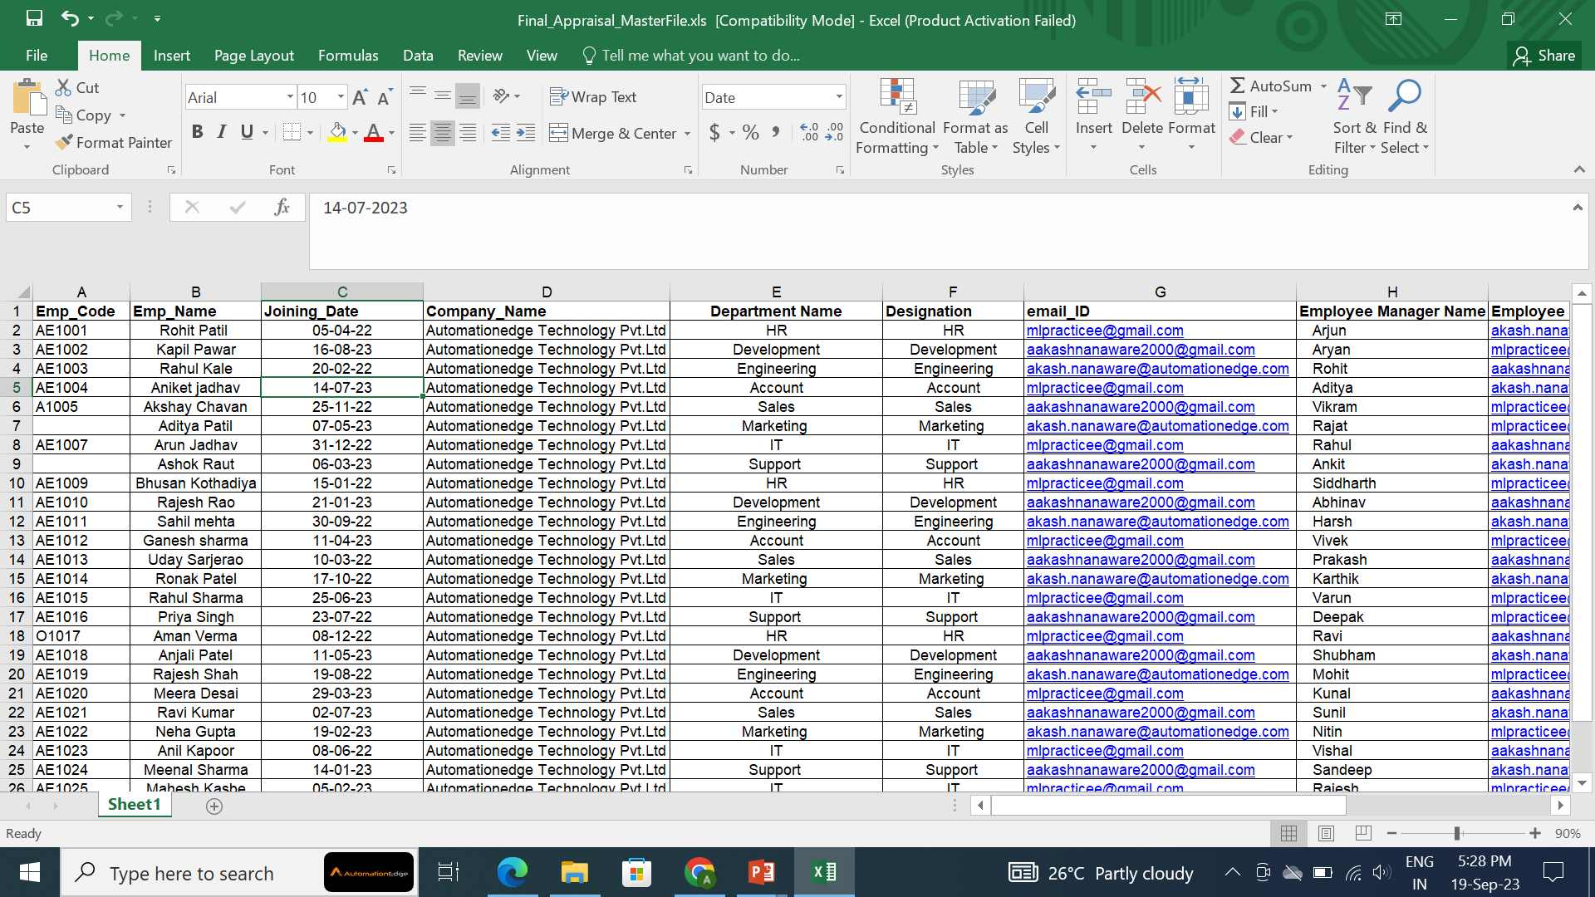
Input File

Slide 8
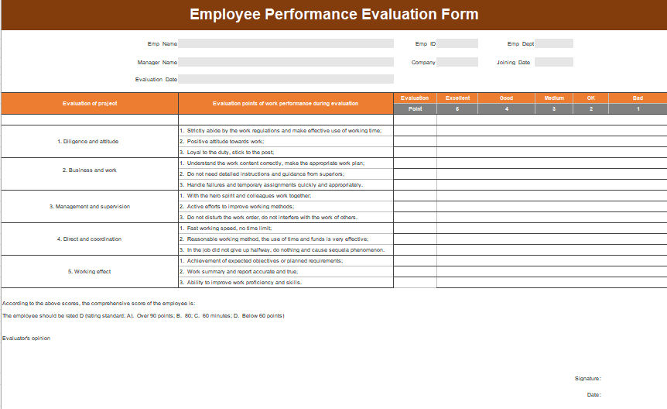
Input File

Slide 9
Save Invalid Data
Project Flow Diagram
Part 1:
No
Yes
Validations & Calculations
Yes
Start
Check Perquisites
Read Input
No
Non- eligible data
No
Check Eligibility
Display Appropriate Msg
Yes
Send Self-
Appraisal Form
End
Store in DB

Slide 10
Project Flow Diagram
Part 2:
Read received mail
Validate
forms
Yes
Start
Update DB
No
Send remainder mail if status is pending
Mail to re-send form
End

Slide 11
Data Flow Diagram
Data processing
Input
Send Email
User
Employee
Invalid data
Appraisal Review Form
Store & update
Take data
Database

Slide 12
Usecase Diagram
Input data and
files
Check and Read
data
User
Validate and Store in DB
Send Mail to
Eligible Emp
Read mail & validate
Bot
Send Reminder Mail
Update Status into DB

Slide 13
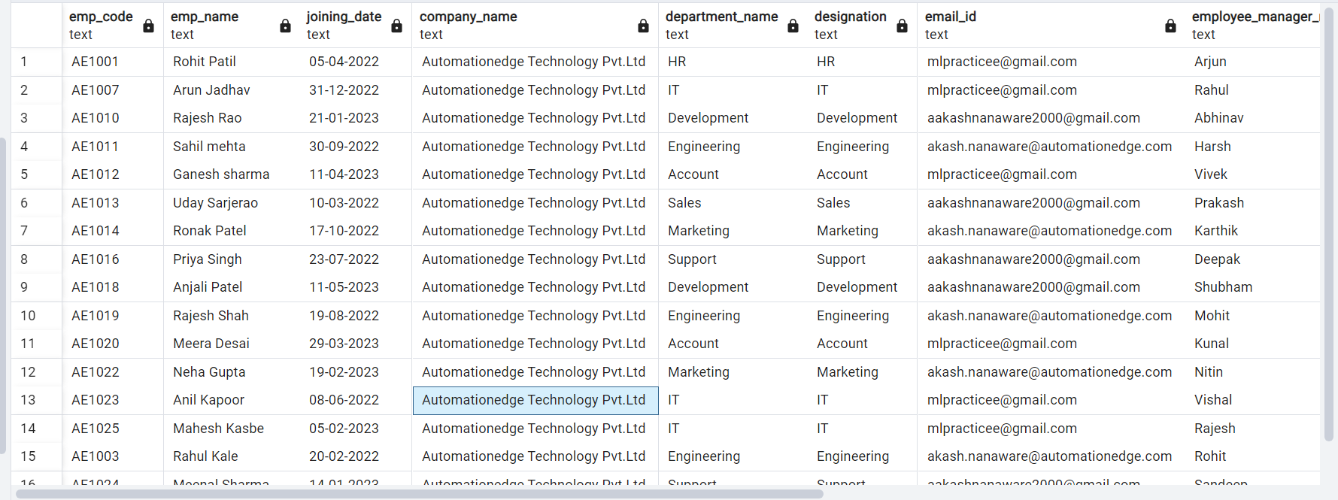
Result (Output File)

Slide 14
Advantages
Saves time
Faster Processing
Data Accuracy
Reusability
Error Reduction
Improved Customer Experience

Slide 15
Limitations
Bot will not download/read the mail, if the subject line doesn’t match.

Slide 16
Conclusion
The HR Appraisal Launch Process efficiently manages the appraisal cycle Through automated emails and schedules.
Reduce the Human Errors
This process reduces manual effort, and contributes to a successful appraisal cycle.

Slide 17
Thank You

